Slide 1
House Price Prediction
By :- Ankur Patel - 18CP066
Vivek Parmar – 19CP311

Slide 2
Introduction
Housing prices keep changing day in and day out and sometimes are hyped rather than being based on valuation.
Using a module we predict a house price based on some attributes.

Slide 3
Process of Project
Here are steps to create a project to predict house price :-
Collect Dataset
Check for dimension of data
Check for missing values in dataset
Check for duplicate rows in dataset
Correlation between attributes
Plot some major dependent attributes and visualize.
Analysis of Variance
Create a Multiple Regression Model
Predict data using model
Generate csv file for Predicted data

Slide 4
Dataset
Dataset contains this attributes :-
ID
Bedrooms
Bathrooms
Floors
Sqft_lot
Sqft_living
View
Condition
Year built
Year renovated
Street
City
Price
and many more

Slide 5
What is Linear Regression?
Linear regression attempts to model the relationship between two variables by fitting a linear equation to observed data. One variable is considered to be an explanatory variable, and the other is considered to be a dependent variable.
For more than one explanatory variable, the process is called multiple linear regression.
The relationships are modeled using linear predictor functions whose unknown model parameters are estimated from the data. This type of model is Linear models.
Before attempting to fit a linear model to observed data, a modeler should first determine whether or not there is a relationship between the variables of interest.
y= a + b1x1 + b2x2 +...bnxn

Slide 6
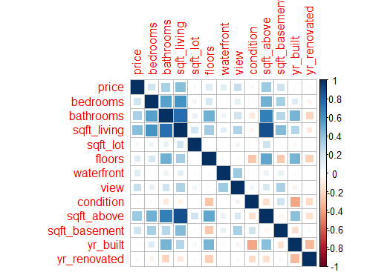
Analysis of Correlation of attributes

Slide 7
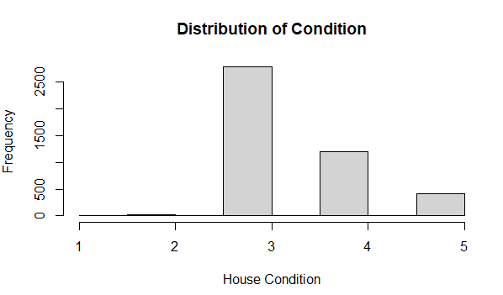
Distribution of Condition of houses

Slide 8
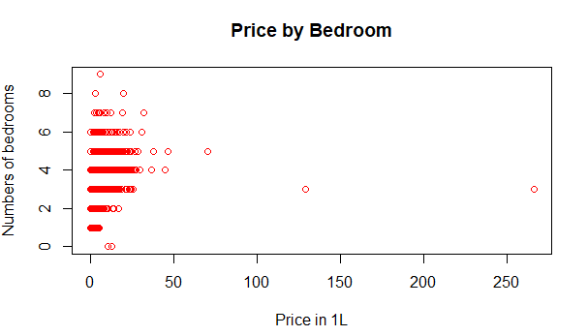
Price by bedroom

Slide 9
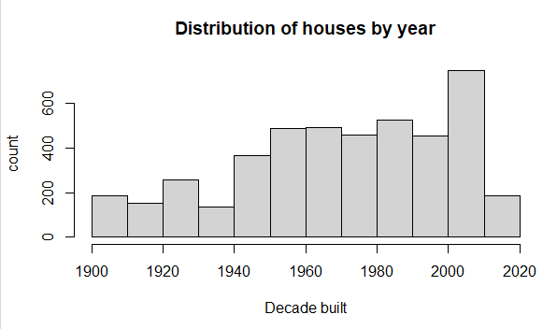
Distribution of house by year

Slide 10
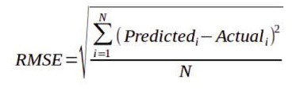
RMSE Function
Root Mean Square Error (RMSE) is the standard deviation of the prediction error.
This measure of how far from the regression line data points are or RMSE is a measure of how spread out these residuals are.
In other words, it tells you how concentrated the data is around the line of the best fit. Root mean square error is commonly used in climatology, forecasting, and regression analysis to verify experimental results.

Slide 11
Demonstrate

Slide 12
Conclusion
Using Multiple Regression we create a model for various attributes and successfully generated predicted data in file “PredictedData.csv”.
We can plot an attributes for visualization and also able to get variations on price versus different attributes.

Slide 13
Thank You

